Slide 1
#TaxDirection as Personalised Recommendations tagged with Individual Taxes enabling Sustainable Hyperlocal Governance promoting Longevity
Santanu Banerjee^{1,5}, Tiyasa Mishra^{2.#}, Anandita Das^{2,#}, Atul Kumar Dubey^{3,%}, Krishna Das^{3,%}
¹ Department of Industrial and Systems Engineering (ISE)⁴ ² Department of Humanities and Social Sciences (HSS)⁴ ³ Rajiv Gandhi School of Intellectual Property Law (RGSOIPL)⁴ ⁴ Indian Institute of Technology (IIT) Kharagpur, West Bengal, India ⁵ Omdena Kharagpur (OK), Local Chapter, India⁶ ⁶ International Society for Enforcing Universal Permanence (InSociEUP), India
# Equal contributions % Equal contributions

Slide 2
Introduction
During decision-making, in most cases due to the inability to satisfy all stakeholders, public grievances are often overlooked, resulting in dissatisfaction and accumulation of problems.
On another aspect, resource scarcity being an international problem, also boils down to chaotic local-level issues especially in a developing nation like India.
One of the reasons behind such decision-making incapability could be the lack of proper decision intelligence through aggregated feedback from the public. In terms of resource and taxation efficiency in India, artificial intelligence (AI) can help in easy and better allocation of resources as well as risk detection related to the taxation system (Kalyanakrishnan et al., 2018).

Slide 3
Literature Review
Philip Taylor (Taylor, 1965) defines tax as a compulsory contribution from the person to the government to defray the expenses incurred in the common interest of all.
A baneful feature of the Indian Tax system is the lack of administrative efficiency. There is no coordination between the taxes to allow a well-organised, planned and coordinated tax system to evolve. The rate of direct tax is very high in India, but the contribution to the total tax revenue is very low (Alagappan, 2019).
Taxes can change the behaviours of the people, affecting their incentives to save. A negative-tax slab could be introduced for the people at the bottom of the economy, allowing a more equitable yearly distribution of wealth and possibly doing equal good instead of channelling the same through government policies, which are generally plagued by corruption (Krishna, 2002 and Gupta, 2017).
In the Indian context, existing studies have not focused on policies integrating tax base broadening, tax rate reduction and administrative reduction in the context of the political economy of tax reform (Bird, 2008).

Slide 4
A proposition of tagging individual problems with respective tax amounts as a soft-guidance mechanism for expenditure

Slide 5
Motivation
Human civilization is on the brink of a climate revolution, and our present decisions will depend on whether we are able to outlive time as a dominant civilization in the Universe or perish into oblivion.
A basic roadblock during most implementation phases seem to be the lack of government interest possibly due to organisational foolishness, laziness and inertia as well as technological gaps and fund availability, for which we may have to run from pillar to post in most countries just to show that a profitable model exists to save the planet.
We must help ourselves in this regard by generating new revolutionary ideas and transforming our steps into swiftly implementable corrective actions for eternal survival of life on Earth

Slide 6
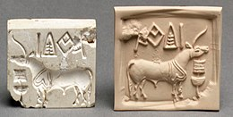
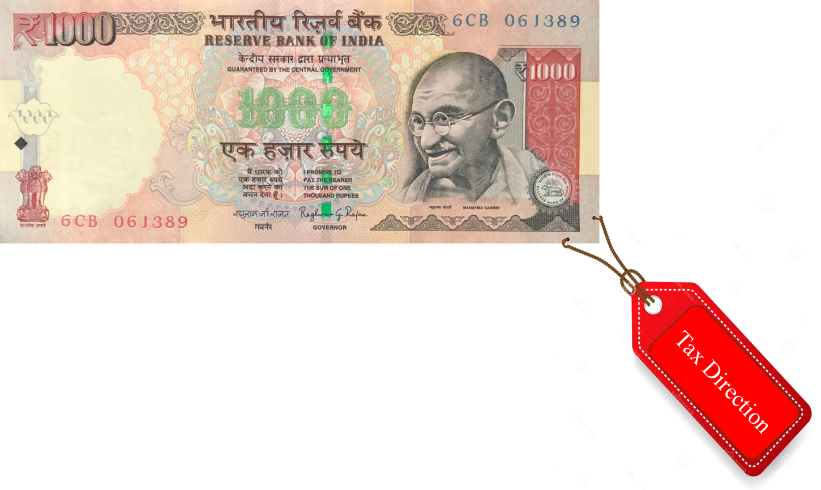
From the barter system to exchange tokens
The existing human civilization has evolved from the basic barter system principles, now using tokens (money) issued by a central authority (the Central/Reserve/Federal Banks).
Tax as we know, being charged from citizens to help the government in public projects, has been existing even 5000 years from now in a similar form (A. Mukhopadhyay, 2018) and its hight time we use modern technologies to evolve its understanding.
Suggestions of what to change, add or incorporate to create a positive impact that would affect the specific suggester, could not have been possible earlier since it would have been hard to keep track of such feedback 5000 years ago. However, the present silicon machines and AI allows a different scenario to evolve altogether, a generation where tax is not only an amount but an information tagged with that amount, an yearly wish-list of sorts.

Slide 7
Envisioning Tax as a Vector, a change in its status from a scalar quantity, for new possibilities
We propose the following sequential framework (Fig. 1) for the development of a pipeline towards financial allocation and automatic creation of project proposals, :
Collection of public feedback from tax portals, including:
Problem Description,
Geographical Location where the problem scenario arises (could also be online, etc.), and
Percentage of his/her tax amount the tax-payer wishes to allocate to solve this specific problem
Data cleaning and pre-processing (includes translation of the feedback language in case the language models used is trained only in English)
Clustering of the Problem Descriptions into problem-specific baskets for each location (i.e. for each location cluster)
Developing an intelligent AI to summarize all the Problem Descriptions within each cluster (a cluster, as defined above, refers to a specific location and a specific problem domain) to create a (one-pager) combined description of all the problems in that cluster, and another (one-pager) project-proposal to solve the cluster-specific problem. The suggested financial allocation to this Project Proposal would be the aggregated tax amounts tagged with the Problem Descriptions in a cluster.

Slide 8
Predicting the Future: A Renaissance in Governance
This form of a suggestion system will ensure unbiased and conscious feedback from the taxpayers.
Powerful language models for problem clustering and cluster summarization would help in obtaining an accurate understanding of the location-specific pain points. As societies develop socio-economically, focus on public health, energy security and water infrastructure, pollution and air quality, as well as human longevity and sustainability would become the prime suggestion factors.
Help locals direct governments towards churning their organismic survival zeal into organizational management. We predict the evolution of the actionable outcomes from such a system to progressively shift towards the longevity of the self, the surrounding and overlapping ecosystems (sustainability), and the planet, enabling us time-bound organisms to introspect profoundly about purposeful existence.

Slide 9
Existing Theories on Tax
The utilitarian theory of taxation is based on the fact that money taken as tax from relatively rich people will do lesser harm to them (in terms of consumption and savings) as compared to the tax taken from the relatively poor ones. The benefits of this theory of taxation include the reach of the taxation, the opinions of the population regarding its implementation, net utility received after contributing towards taxation and alternative options if the net utility obtained is insufficient (Bezhanyan, 2018).
Integrating AI into the system will bring more transparency in the process, supplementing the development of problem-specific projects through our novel suggestion of aggregating tax-amount-weighted public feedback.
Though the basic definition of taxes and externalities indicates that the taxpayers’ activities will not give direct benefit to them, Tax Direction will benefit the majority of taxpayers, thus fulfilling the objective of Pareto optimality (Hochman et al., 1969 and Stiglitz, 1987) to a good extent.

Slide 10
Negative repercussions of implementing Tax-Direction (The Devil’s point of view)
As more and more voices get heard, new infrastructure development in remote, isolated areas could be affected since there would be fewer data points due to a smaller population. As an analogy with particle physics, it would only provide matter as the feedback, and the dark energy would be left out.
People’s decision-making, just as it is influenced through promotions by political parties before elections, would similarly be influenced by corporations and large organisations by promoting specific problems among the masses and favouring their invented method of solving a problem.
Remedies:
An intensive approach must be developed, as well as understanding the problems of the life forms that are unable to express their insights.
A limit to budget allocation by influencers (Alon et al., 2012 and Staib et al., 2017) should also be put forth, similar to the expenditure limitation of political parties during elections (as is the case in India).

Slide 11
Certain influences on decision-making
Political Considerations: The intricate relationship between personal decisions and political factors sheds light on how individuals are inevitably influenced by the ever-changing dynamics of the political sphere, evidently in matters of civic management.
Social Considerations: Cultural norms and values shape individual decisions, reflecting the intricate relationship between individual decision-making and societal expectations.
Technological considerations: The manipulation of portals would reverse feedback, which will hide the reality, leading to the formulation and implementation of harmful policies.

Slide 12
Conclusion
Parliament’s exercise of power reflects the aspirations of citizens, envisaged as the Directive Principle of State Policy (DPSP) under Part IV of the Constitution. DPSP are regarded as a conscience of the nation set forth the humanitarian socialist precepts (K. Bharati v. State of Kerala, 24th April 1973). We draw an analogy suggesting that what (static) DPSP does towards helping in guiding governance, tax-direction (dynamic) would do similar towards policy-making as it would be the accumulation of the problems, solutions, wishes and aspirations of the majority of the responsible citizens alive today.
Both DPSP and #TaxDirection are essential soft-control towards decision-making.
Alongwith existing feedback mechanisms of the GOI including IdeaBox and ViksitBharat@2047, #TaxDirection would play a major role in integrating hyperlocal-problem solutions towards the direction of a futuristic developed nation. The idea is to fulfil the citizens' dream of making India a developed country by enhancing its openness and independence.

Slide 13
References
Ahamed, Sarah & Singh, Avinash. (2021). Research on Aging And Longevity In India: Historical Background, Present Status and Future Directions.
Alagappan, S. M. (2019). Indian Tax Structure–An Analytical Perspective. International Journal of Management, 10(3), pp. 36-43.
Alon, N., Gamzu, I., & Tennenholtz, M. (2012, April). Optimizing budget allocation among channels and influencers. In Proceedings of the 21st international conference on World Wide Web (pp. 381-388).
Ansumali Mukhopadhyay, Bahata, (2018, June) Ancient Tax Tokens, Trade Licenses and Metrological Records?: Making Sense of Indus Inscribed Objects Through Script-Internal, Contextual, Linguistic, and Ethnohistorical Lenses. DOI: 10.2139/ssrn.3189473.
Austin, Granville (1972). The Indian Constitution: Cornerstone of a Nation, Bombay: Oxford University Press (13th ed., 2008).
Bandyopadhyay, S. (2017). Goods and Services Tax: Challenges and Opportunities. Centre for Budget and Governance Accountability (CBGA).
Bezhanyan, R. (2018). Utilitarianism and tax policies (Doctoral dissertation).
Bird, R. M. (2008). Tax challenges facing developing countries. Institute for International Business Working Paper, (9).
Ekelund, R. B., Jr., Resseler, R. W., & Tollison, R. D. (2006). Microeconomics: Private markets and public choices (7th ed.). Boston: Addison Wesley.
Gupta, A. (2015). Problems of double taxation in India-a case for progressive GST (goods and services tax). Journal of Commerce and Management Thought, 6(3), 456-476.
Gupta, A. (2017). Changing Forms of Corruption in India. Modern Asian Studies, 51(6), 1862-1890. DOI:10.1017/S0026749X17000580
Hayek, F. A. (2013). The use of knowledge in society. In Modern Understandings of Liberty and Property (pp. 27-38). Routledge.
Hochman, H. M., & Rodgers, J. D. (1969). Pareto Optimal Redistribution. The American Economic Review, 59(4), 542–557. http://www.jstor.org/stable/1813216
Huang, Z. (2018). Discussion on the development of artificial intelligence in taxation. American Journal of Industrial and Business Management, 8(08), 1817.
Kalyanakrishnan, S., Panicker, R. A., Natarajan, S., & Rao, S. (2018, December). Opportunities and challenges for artificial intelligence in India. In Proceedings of the 2018 AAAI/ACM conference on AI, Ethics, and Society (pp. 164-170).
Kaur, G. (2016). Self-assessment system of taxation as a challenge for India. International Journal of Advanced Education and Research, 1(3), 9-11.
Kesavananda Bharati v. State of Kerala, AIR 1973 SC 1461.
Krishna K. Tummala (2002) Corruption in India: Control measures and consequences, Asian Journal of Political Science, 10:2, 43-69. DOI: 10.1080/02185370208434210
Kumar, R. (2019). India's science and technology funding: Time for a rethink? Nature India. DOI: 10.1038/nindia.2019.83
Kumar Y. (2019). Understanding the Frontiers of Human Longevity in India: Imperative and Palliative Care. Indian journal of palliative care, 25(3), 455–461. DOI: 10.4103/IJPC.IJPC_20_19
Mehta, L. (2007). Whose scarcity? Whose property? The case of water in western India. Land use policy, 24(4), 654-663.
Rao, M. G. (2005). Tax system reform in India: Achievements and challenges ahead. Journal of Asian Economics, 16(6), 993-1011.
Rao, M. G. (2016, July). Tyranny of the Status Quo: The Challenges of Reforming the Indian Tax System. In Indian Policy Forum 2015 (Vol. 16, No. 12, pp. 47-101).
Rathi, A., Sharma, S., Lodha, G., & Srivastava, M. (2021). A study on application of artificial intelligence and machine learning in Indian taxation system. Psychology and Education Journal, 58(2), 1226-1233.
Singh, Mahendra Pal (2008). V.N. Shukla's Constitution of India. Lucknow: Eastern Book Company (11th ed., pp 345-346).
Staib, M., & Jegelka, S. (2017, July). Robust budget allocation via continuous submodular functions. In the International Conference on Machine Learning (pp. 3230-3240). PMLR.
Stiglitz, Joseph E. (1987): Chapter 15 Pareto efficient and optimal taxation and the new welfare economics, in: Handbook of Public Economics, pp. 991–1042, DOI: 10.1016/s1573-4420(87)80010-1.
Taylor, P. E. (1965). The Role of Direct and Indirect Taxes in the Federal Revenue System.
Tyagi, Anjali, An Analysis of Indian Tax Structure (November 12, 2021).

Slide 14

Thank You Please start tagging your taxes with a proper direction here →
Correspondence Emails: santanu@kgpian.iitkgp.ac.in, tiyasamishra@kgpian.iitkgp.ac.in, ananditadas7@kgpian.iitkgp.ac.in, atuldubey@kgpian.iitkgp.ac.in, krishnadas@kgpian.iitkgp.ac.in

